Slide 1
Art Pieces Invest in something beautiful.

Slide 2
Agenda
Important Notes
Problem breakdown
Proposed Solution
Transaction data structure
Program Flow
Demo

Slide 3
Important Notes
The full submission is on my Google Drive and the link is in the readme.
The system uses a Postgres database and has a React frontend which will require some setup.
I have included a thorough step-by-step setup guide titled: “Set Up Guide.docx” in my submission to guide you through the process.

Slide 4
Problem Breakdown
High-end artworks and collectibles are typically inaccessible to everyday investors.
Tokenizing artworks and collectibles using blockchain technology enables fractional ownership.
This fractional ownership opens the market to a broader range of investors.
Investors can buy, trade, and sell percentages of an artwork.
This increases liquidity in a traditionally illiquid market.
Blockchain ensures a transparent and reliable history of transactions and ownership.
The system limits the risk of fraud and ensures nonrepudiation
Notes:
High-end artworks and collectibles are often out of reach for everyday investors, however, tokenizing these artworks using a blockchain system could enable fractional ownership of these items thereby opening the market sector to a much wider range of investors. These investors could then purchase a percentage of an artwork instead of the whole item itself which would increase liquidity in a highly illiquid market. Furthermore, the use of the blockchain system will provide a transparent and reliable history of transactions and ownership thereby limiting the risk of fraud and ensuring nonrepudiation.

Slide 5
Proposed Solution
Create tokens to represent percentage ownership of artworks.
Individuals can buy tokens.
Artworks undergo a verification process to ensure authenticity.
Verification findings are recorded on the blockchain for an immutable authenticity record.
Post-verification, items are tokenized using a smart contract.
Tokens represent percentage ownership of the verified artwork or collectible.
Notes:
The proposed high-level solution would entail creating blockchain tokens that will represent a percentage ownership of a particular artwork or collectible that can then be purchased or sold by an individual. Additionally, the artworks and collectibles would need to go through a verification process to ensure that it is authentic, the findings of that process are also recorded within the blockchain to ensure that each item has an immutable record proving its authenticity. Following the verification process the artwork or collectible can then be tokenized using a smart contract or a tokenization platform. Tokens can then be purchased and will represent a percentage ownership of a selected artwork or collectible.

Slide 6
Transaction data structure
Two main types:
Token smart contract
Token transaction

Slide 7
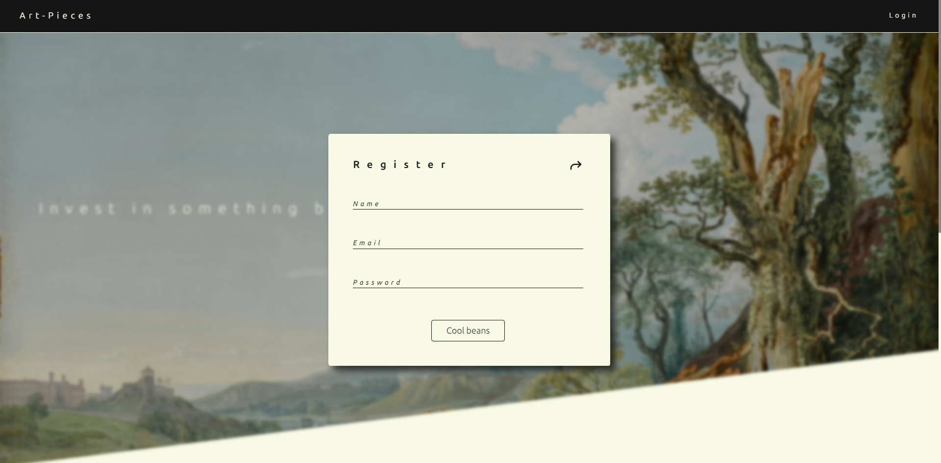
Program Flow - Register

Slide 8
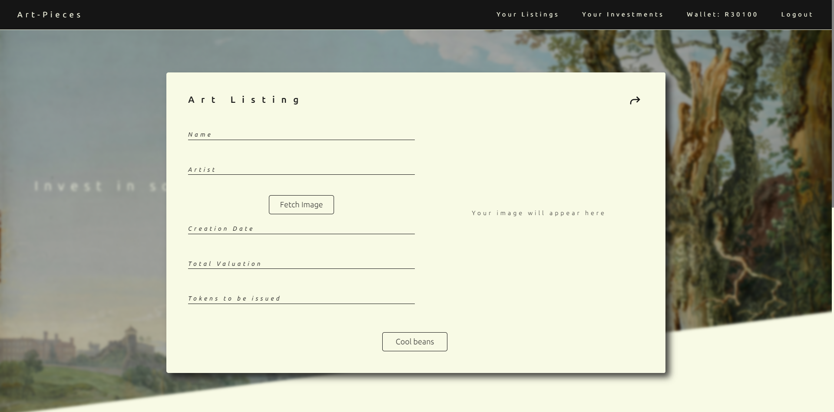
Program Flow – List Artwork

Slide 9
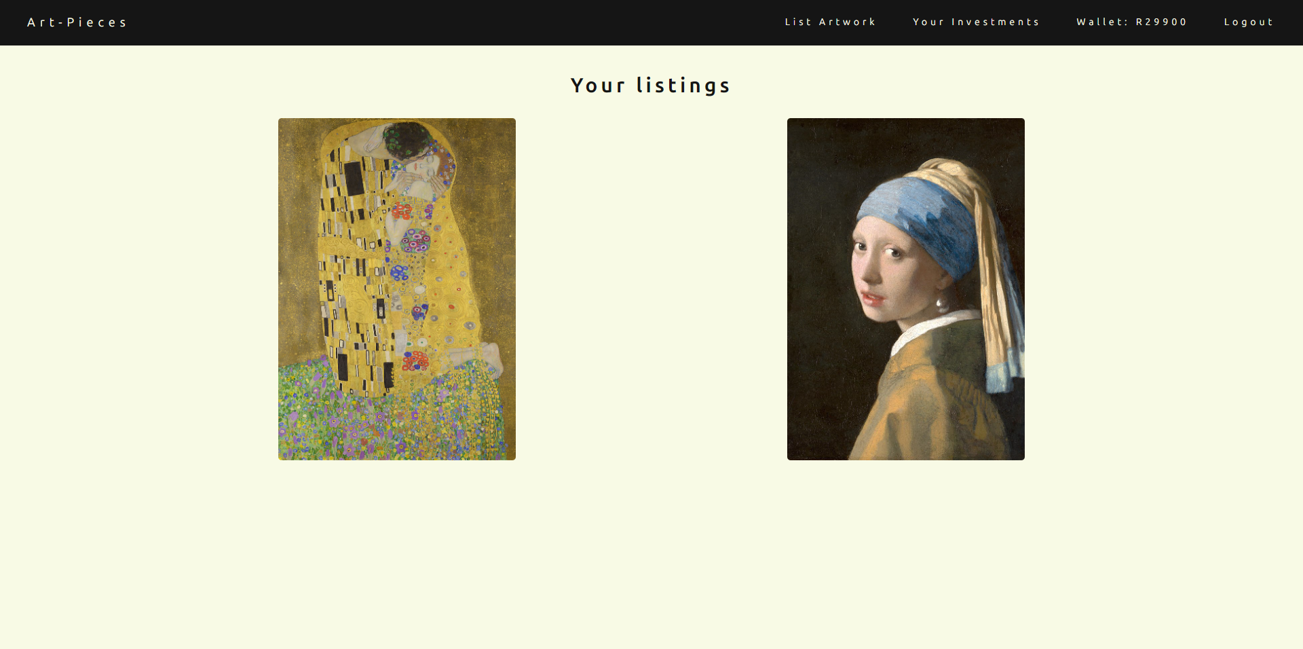
Program Flow – View Listed Artwork

Slide 10
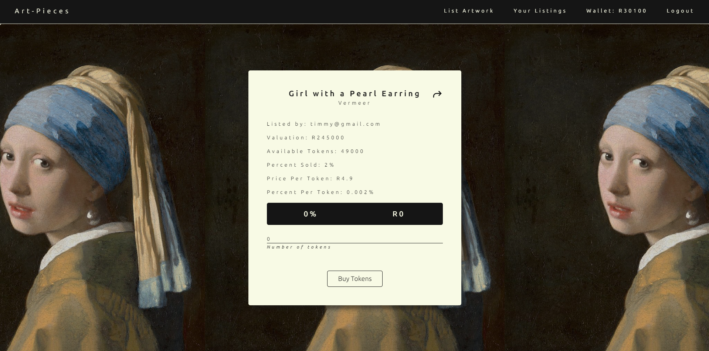
Program Flow – Purchase Tokens (different user)

Slide 11
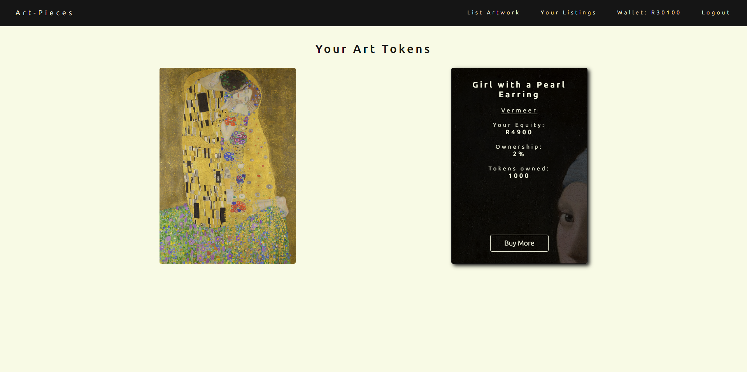
Program Flow – View your tokens (different user)

Slide 12
Time for the demo

Slide 13
Thank you
Brita Tamm
502-555-0152
brita@firstupconsultants.com
www.firstupconsultants.com

